Slide 1
Promise and Future
08/08/2021

Slide 2
General
A way to communicate between two threads (?)
Create a promise object, and then create a future object ON that promise object
Promise is a setter, and Future is like a getter

Slide 3
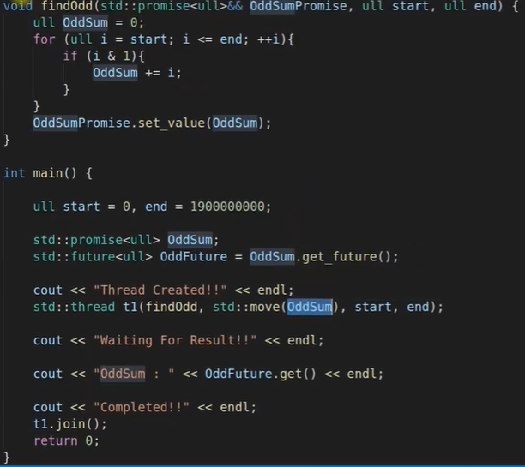
Example
Thread creation removes the time by:
3 secs for fnc
5 secs for jobs before function return is needed to be printed
Would be 5+3 = 8 secs
Now, 3 secs is done simultaneously with the 5 secs, so 5 secs total

